Slide 1
Water-Sorption Characteristics of Clay Minerals
Si sabes conectar, tienes
Emmanuel Durant, Tolsa, North America Sales Manager
1

Slide 2
Introduction
This presentation will detail the water absorption properties of clays and other mica minerals.
Samples of the following groups were tested:
Kaolinite-(Kaolin, Halloysite)
Montmorillonite-(Sodium, Calcium, Hectorite, Nontronite)
Mica-(Illite, Muscovite, Biotite)
Chlorite groups-(Repidolite, Chlorite, Prochlorite)
Sepiolite-attapulgite-palygorskite

Slide 3
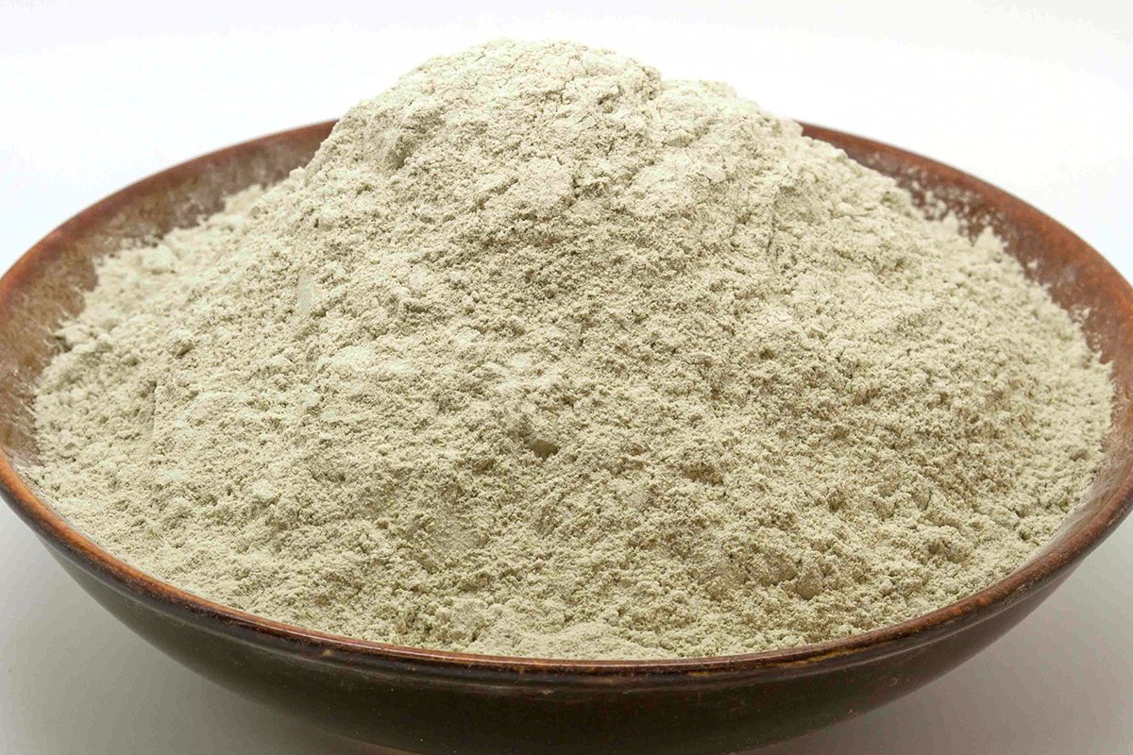
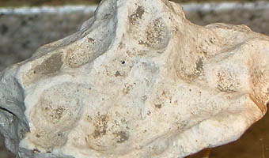
What are clays?
A clay material is any ﬁne-grained, natural, earthy, argillaceous material.
Clays are composed essentially of a small group of extremely small crystalline particles of one or more members of a group of minerals that are commonly known as the clay minerals.
The clay minerals are hydrous aluminum silicates.
Not all clays are alike !!!!!
They each have different characteristics !!!!!

Slide 4
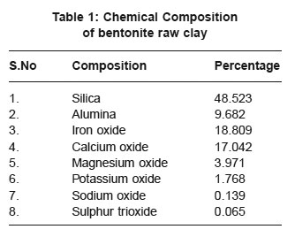
Clays
Clays are not 100% pure
They contain essentially a small group of extremely small crystalline particles of one or more members of a group of minerals that are commonly known as the clay minerals.
An example is a kaolin that has a small percentage of smectite present. This may alter the low and high shear viscosity detrimentally.
Different clays have different compositions.

Slide 5
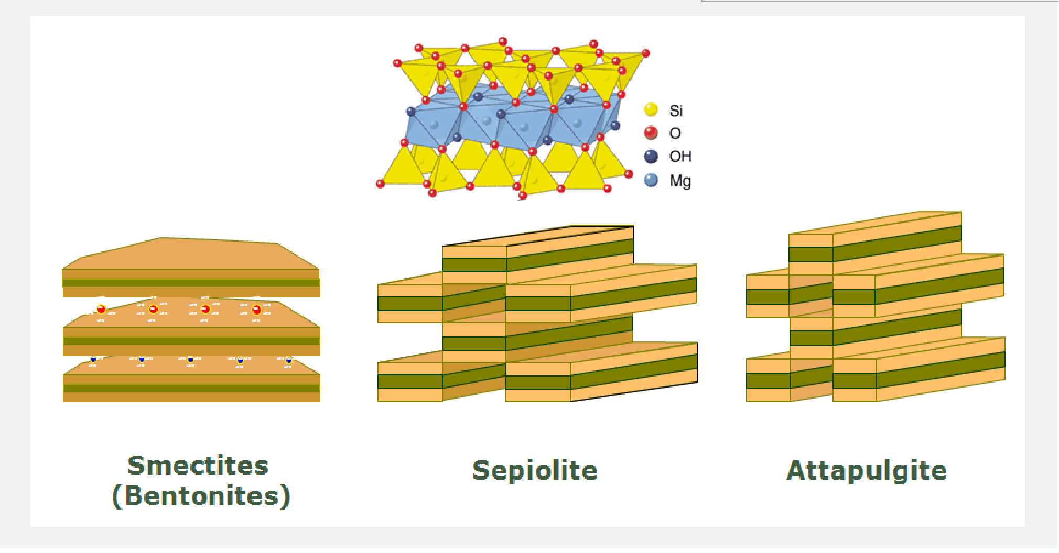
Clays

Slide 6
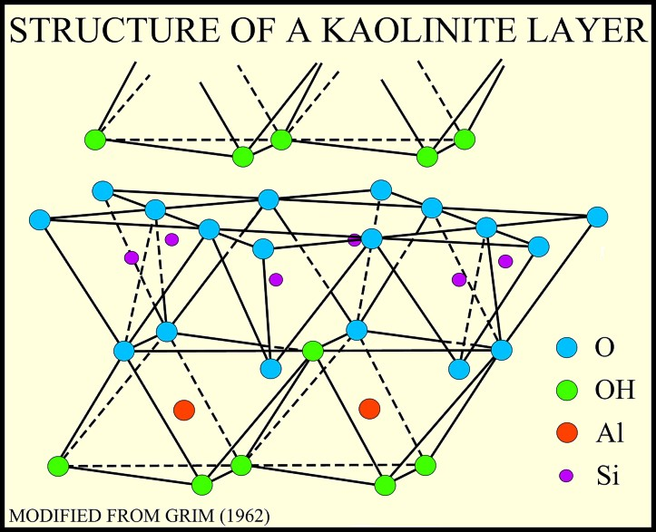
Kaolinite Clays
Kaolinite crystallites are composed of basic silicate layers each of which consists of a silica sheet and an alumina sheet, and these basic layers are bonded together in the c direction by weak hydrogen bonds.
Halloysite 4H20 has a structure similar to that of kaolinite except that halloysite has a layer of water between each two basic silicate layer

Slide 7
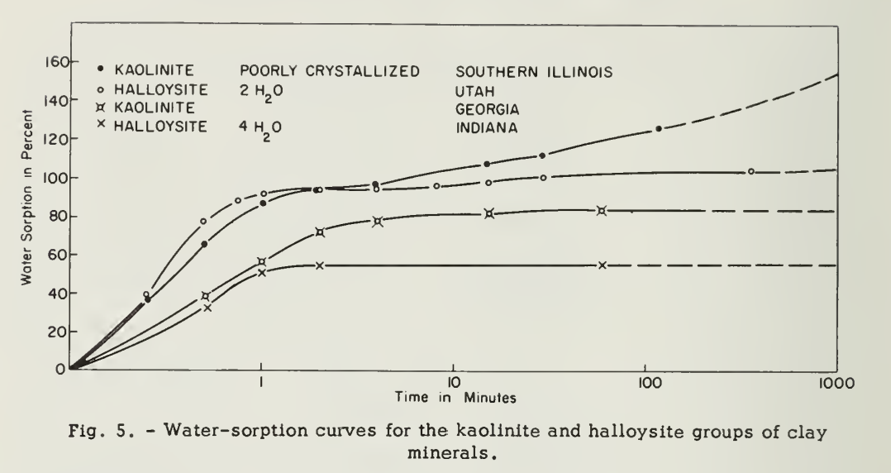
Kaolinite Group
Enslin water sorption apparatus used. 0.5g used of each sample then read in time intervals.
The data from figure 5 indicate that the kaolinite clay minerals will adsorb most of their water in the first minute. The poorly crystallized kaolinite took up 92 percent in the first minute and the well crystallized kaolinite 56 percent. Halloysite 4H2O did not take up any more water (54 percent) after two minutes; halloysite 2H20 and the well crystallized kaolinite had very little adsorption after four minutes (95 and 78 percent, respectively); the poorly crystallized kaolinite had considerably more water adsorption than the other kaolinite minerals after the initial sorption (125 percent at 120 minutes). The halloysite 2H2O took up almost twice as much water as halloysite 4H2O, and the poorly crystallized kaolinite took up about 50 percent more water than the well crystallized variety. The probable mechanism for the absorption after the initial sorption is probably the splitting apart of kaolinite aggregates or booklets that are more weakly bonded by either stretched hydrogen bonds or van der Waal's forces.

Slide 8
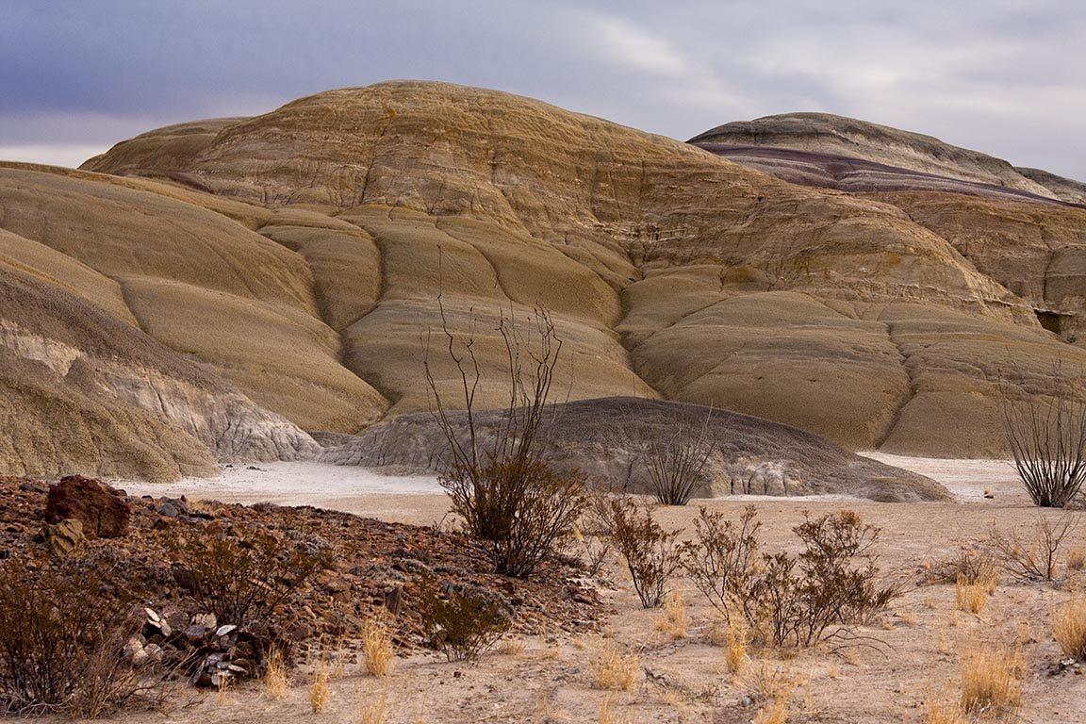
Montromollinite
Sodium(Swell) and Calcium(Non-Swelling) Montromollinite.
Bentonite is a clay generated frequently from the alteration of volcanic ash, consisting predominantly of smectite minerals, usually montmorillonite.
The main constituent, which is the determinant factor in the clay's properties, is the clay mineral montmorillonite.
The color of smectites can vary from tan to brown to brownish green or blue green and is rarely white.

Slide 9
Montmorillonite
Calcium montmorillonite is the most predominate of the smectite minerals and is found in many areas of the world.
Sodium montmorillonite is relatively rare in occurrence in comparison with calcium montmorillonite.
The largest and best-known occurrence of sodium montmorillinite is in the states of Wyoming and Montana in the United States.
Tolsa’s Bentonite in the USA is found in Casper, Wyoming.

Slide 10
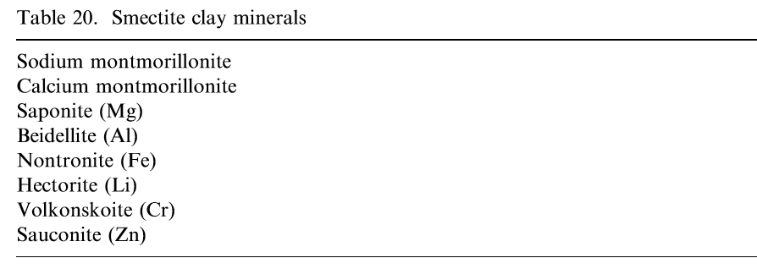
Bentonite
Bentonites are comprised predominantly of the smectite group of minerals. Table below shows the clay minerals that make up the smectite group.
The most common are sodium and calcium montmorillonites.

Slide 11
Bentonite
Sodium montmorillonites important properties related to their use are
viscosity,
High swelling capacity,
thixotropy,
impervious ﬁlter cake,
dispersability.
For the calcium montmorillonites important properties related to their use are
high absorption capacity
Low swelling
bonding strength
bleaching capability.
Sodium bentonites are noted as high swelling clays and calcium bentonites as low swelling clays !!!!

Slide 12
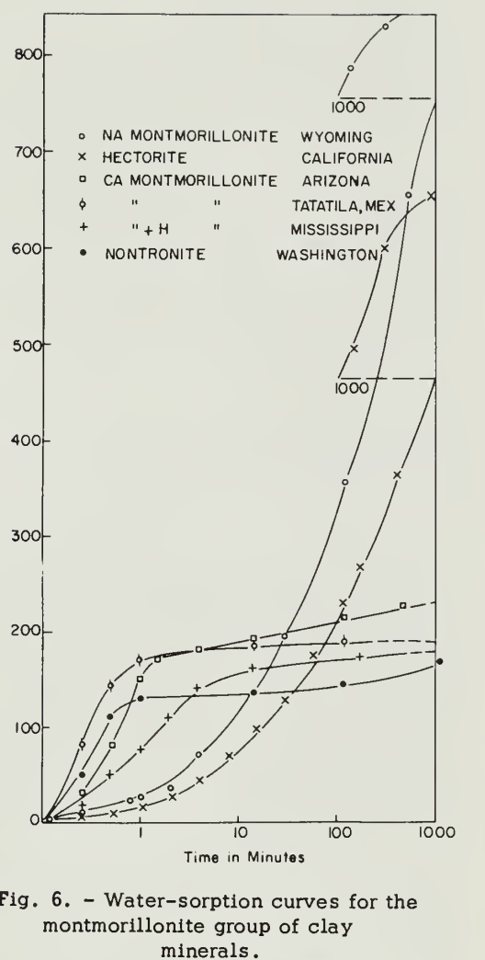
Montmorillonite
The montmorillonites (fig. 6) show a wide variation in their water-sorption abilities. The sodium montmorillonites from Wyoming and hectorite from California take up several times more water than do the other montmorillonites. In 10, 000 minutes the sodium montmorillonite took up about 250 percent more water than hectorite did.
The order of water sorption at 1000 minutes is Wyoming montmorillonite 756 percent; hectorite 464 percent; Arizona montmorillonite 232 percent; Tatatila montmorillonite 184 percent; Mississippi montmorillonite 180 percent; and nontronite 164 percent.
The interpretation of the data, as shown in figure 6, suggests that water-sorption characteristics are a function of the structure and of the exchangeable cations. The Wyoming and Hector montmorillonites for the most part contain sodium as ex- changeable cations, but those from Arizona, Mexico (montmorillonite), and Washington (nontronite) contain calcium as the chief exchangeable cations. The montmorillonite from Mississippi contains calcium and hydrogen as exchangeable cations.

Slide 13
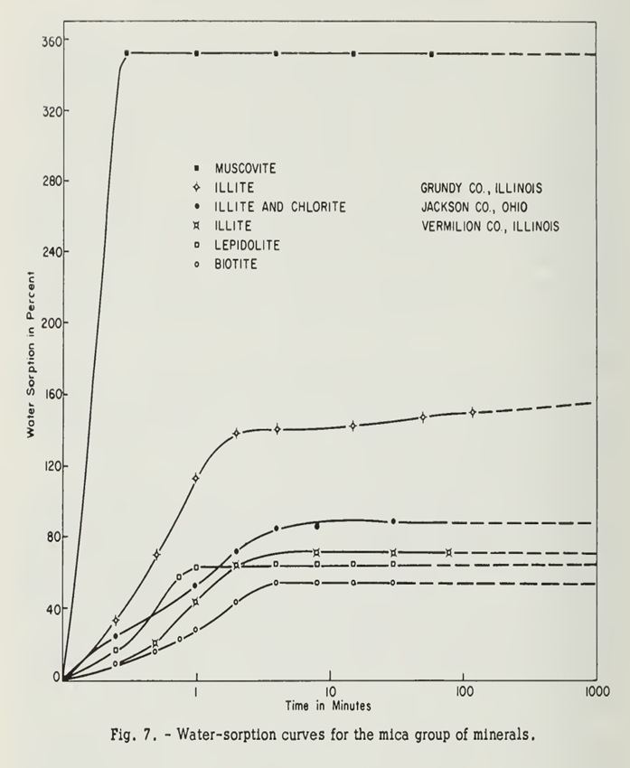
Micas
Micas do not expand in water or organics, but montmorillonite, on the other hand, will expand in water and in certain organics. The mixed-lattice clay minerals that have some of the properties of both the true micas and montmorillonite will expand some when placed in water or organic compounds . The amount of expansion will depend on the percentage of potassium in the lattice.
The data from figure 7 indicate that there is quite a variation in the watersorption properties of the various micas. Muscovite (352 percent) took up about 2x times more water in 15 seconds than the illite from Grundy County, Illinois, did in two minutes. The Grundy County illite (150 percent) took up almost twice as much water in two minutes as the other micas, except muscovite, did in four minutes. The illite-chlorite (88 percent) from Jackson County, Ohio, took up more water than the Vermilion County illite (72 percent), which in turn adsorbed more than lepidolite (64 percent) . Biotite (54 percent) took up the least of any of the micas.
After the initial water was taken up (one to four minutes), there appeared to be no more sorption for the micas except for the Grundy County illite, which continued to adsorb water slowly.

Slide 14
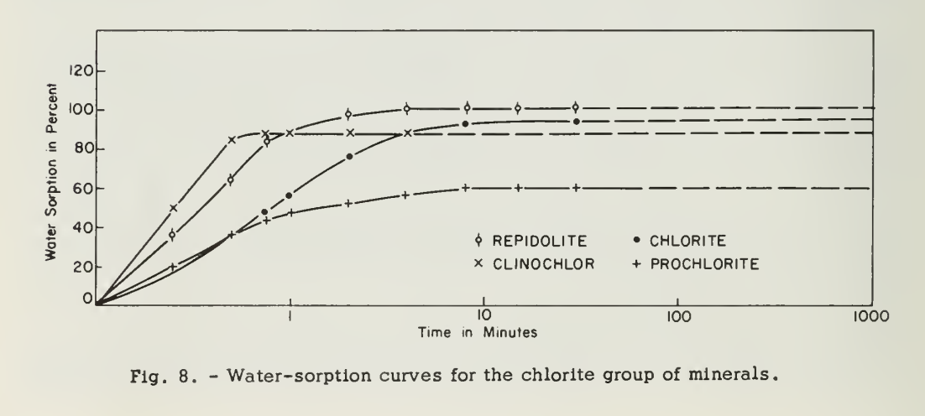
Chlorite & Chloritic Clay Minerals
The chlorites and chloritic clay minerals are mica-type minerals which differ from the true micas in having brucite layers that replace the potassium between the mica layers.
The chlorites (fig. 8) seemed to adsorb more water than the micas (except muscovite and Grundy County illite), probably averaging about 20 to 40 percent more. After the initial sorption, there appeared to be no more adsorption. The order of water sorption is repidolite (100 percent in four minutes) > chlorite (94 percent in eight minutes) > clinochlor (88 percent in 30 seconds) > prochlorite (60 percent in eight minutes). This could be a function of particle size and packing.

Slide 15
Chlorite & Chloritic Clay Minerals
*The chlorites give sorption curves (fig. 8) very similar to those of the micas and illites (fig. 7). From the curves it would appear that the same forces are active in the water sorption of both chlorites and micas.

Slide 16
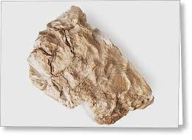
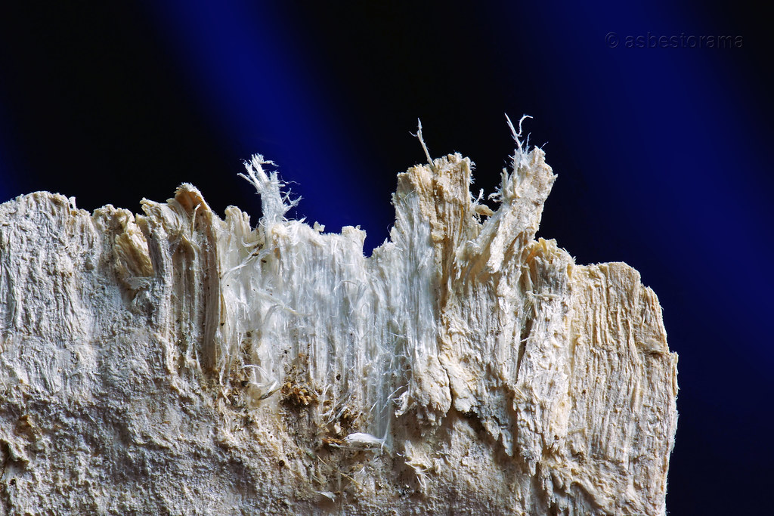
Sepiolite
What is Sepiolite?
Sepiolite is a hydrated magnesium silicate with the ideal formula Si12Mg8O30(OH)4(OH2)4.8H2O.
Sepiolite, unlike other clays, is not a layered phyllosilicate. Think needle like properties.
Non-swelling, lightweight, porous clay with a large specific surface area. Unlike other clays, the individual particles of sepiolite have a needle-like morphology.
Sepiolite has a very large surface area around 300 m2/g.

Slide 17
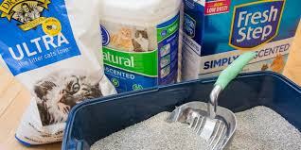
Sepiolite
Sepiolite has the highest surface area (BET , N2) of all the clay minerals.
About 300m2/g, with a high density of silanol groups (-SiOH) which explains the marked hydrophilicity of this clay. The silicate lattice has not a significant negative charge and therefore the cation exchange capacity of this clay is very low.
The high surface area and porosity of sepiolite account for the remarkable adsorptive and absorptive properties of this clay.
It absorbs vapors and odors and can absorb approximately its own weight of water and other liquids.
Think cat litter!

Slide 18
Attapulgite
Attapulgite is a hydrated aluminum silicate mineral.
Attapulgite and Palygorskite are synonymous.
Attapulgite is non-swelling with needle like properties.
Sepiolite is structurally similar to palygorskite=attapulgite except that it has a slightly larger unit cell. Therefore Sepiolite will have better rheological properties.
The attapulgite needle is typically about 1 micron in length and approximately 0.01 microns across.

Slide 19
Attapulgite & Sepiolite
Remember that elongate thin particles cause high viscosity when added to any liquid. It is a physical and not a chemical viscosity, so its very stable as a viscosiﬁer and suspending medium in many applications where sodium montmorillonite (bentonite) would ﬂocculate when the salt or electrolyte concentration is high.
Sepiolite has a working ph range of 2-14
Attapulgite had a working ph range of 4-14

Slide 20
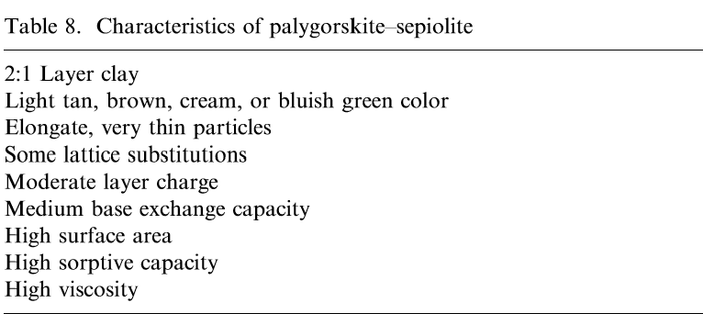
Attapulgite & Sepiolite Characteristics

Slide 21
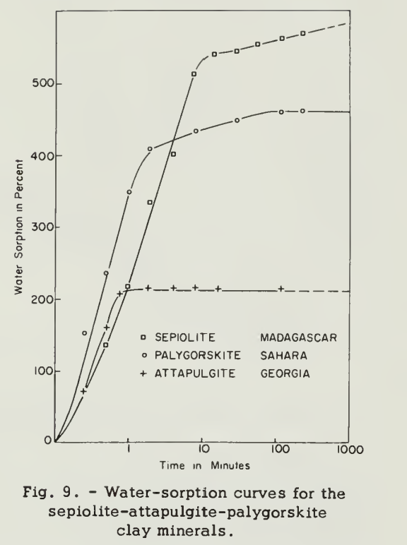
Attapulgite & Sepiolite
The data (fig. 9) indicate that there is a wide variation in the adsorption properties of the sepiolite-attapulgite-palygorskite group. Sepiolite (568 percent) adsorbs the most; palygorskite (460 percent) adsorbs about 100 percent less than
sepiolite; and attapulgite (212 percent) adsorbs less than half that of palygorskite.
After the initial water sorption, attapulgite behaved like the micas and chlorites
by not adsorbing any more water after one minute, whereas sepiolite and palygorskite continued to adsorb water after ten and two minutes, respectively, after the
initial water was adsorbed.

Slide 22
Attapulgite & Sepiolite
It is suggested that the difference in the properties between the clay minerals may be attributed to differences in crystal morphology which in turn may be due to differences in structure.
Since the particles would have a random orientation, the broader particles would tend to create larger pore spaces through which the water could enter, which might explain the higher water sorption of sepiolite and palygorskite.

Slide 23
Conclusion
1. In kaolinite and halloysite, water sorption takes place rapidly.
2. In montmorillonites the rate and amount of water sorption depends to some
extent on the exchangeable cation. The montmorillonite adsorbs water more slowly
than the other clay minerals and also adsorbs more water than the others. The sodium montmorillonite will adsorb considerably more water than will the calcium
Montmorillonites
3. The water sorption for the micas is completed in a few minutes.
4. The chlorites have water- sorption curves similar to those of the mica
clay minerals, biotite and lepidolite.
5 . The water sorption for sepiolite, palygorskite, and attapulgite is rapid
at first. The water sorption for attapulgite was completed in one minute and was
nearly completed for sepiolite and palygorskite in four minutes. Attapulgite differed from the other two in that water sorption was completed after the initial adsorption.
6. Only sodium montmorillonites adsorbed more water than sepiolite and
palygorskite. Attapulgite adsorbed about the same percentage of water as did the
calcium montmorillonite.

Slide 24
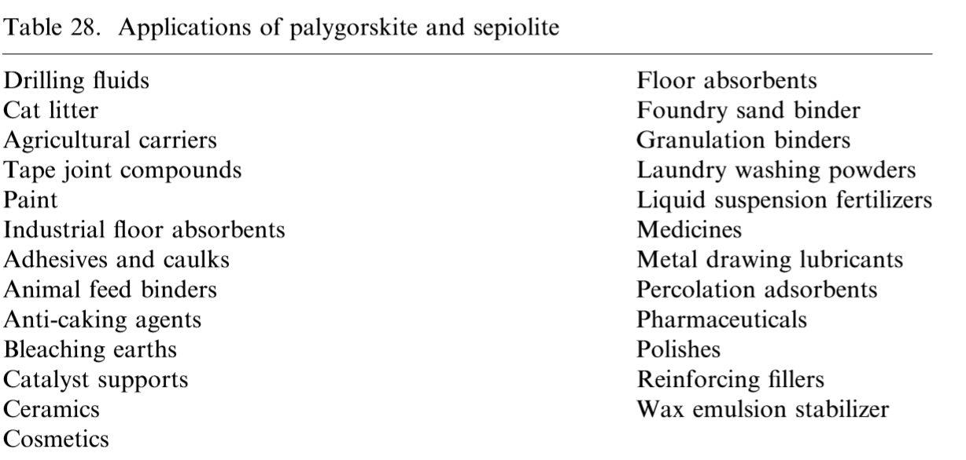
Applications of Attapulgite & Sepiolite

Slide 25
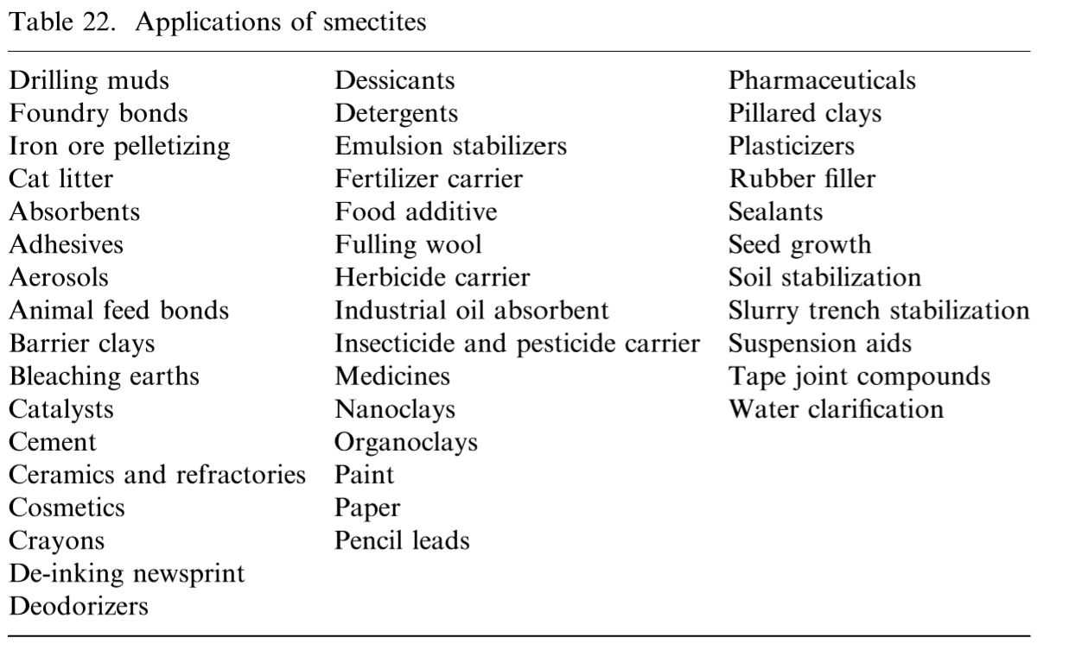
Bentonite Applications

