Slide 1


Tolsa Products for
Paints & Coatings
Training Sessions
2018
Notes:
1

Slide 2
Our Products
Pangel products are highly pseudoplastic additives based in different silicate minerals for both water and solvent based systems.
water-borne solvent-borne
Pangel S series Pangel B series
Pangel M series Pangel OM/OMD series
Pangel W series
Microspheres series from Tolsa includes light fillers as FILLITE and MICROSIL for weight reduction while workability is improved, and solid microspheres as PANSIL ULTRASPHERES for barrier and mechanical coatings properties with minimal impact on viscosity

Slide 3
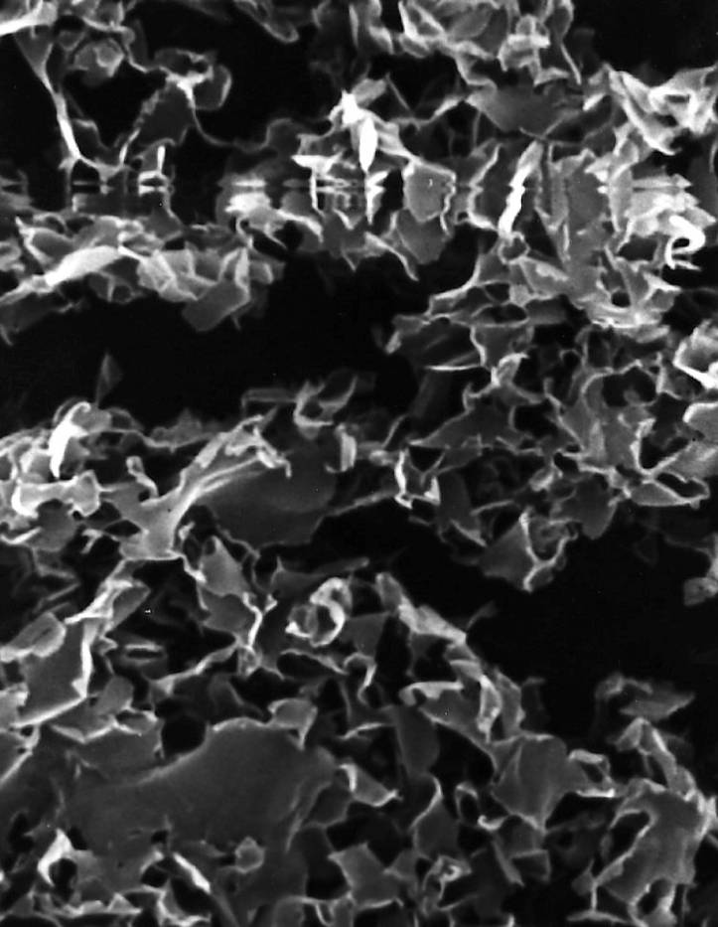
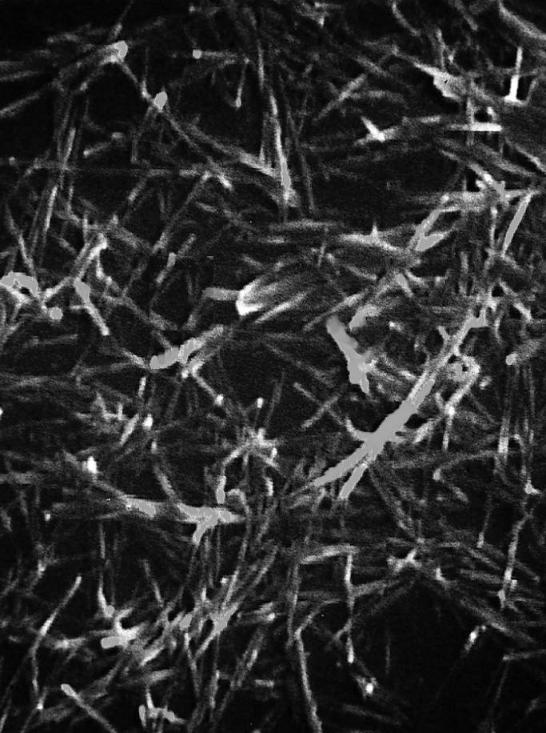
Bentonite & Sepiolite
Bentonite (Smectites)
Sepiolite & Attapugite

Slide 4
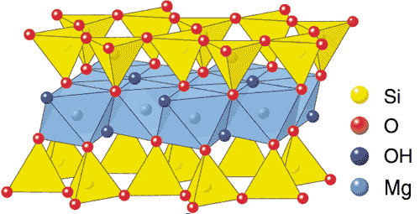
Special Clays Structure
H2O
H2O
H2O
H2O
H2O
H2O
H2O
H2O
H2O
H2O
H2O
H2O
H2O
Ca
H2O
H2O
Ca
H2O
H2O
Ca
H2O
H2O
Ca
H2O
H2O
H2O
H2O
H2O
H2O
H2O
H2O
H2O
H2O
H2O
Na
H2O
H2O
Na
H2O
H2O
Na
H2O
H2O
Na
H2O
H2O
Na
H2O
H2O
H2O
H2O
H2O
H2O
Smectites
(Bentonites)
Sepiolite
Attapulgite
Notes:
On the top of the slide we have the chemical structure of a Silicate with the metal oxide between to layers of silicon oxide. This chemical identity can be found in both, the chemical structure of bentonite (on the left) and sepiolite (on the right). The main differences between the sepiolite and bentonite are:
Bentonite has a extended silicate structure forming sheets against a needle like shape for sepiolite.
The layer of bentonite holds a fairly high density of negative charge that is compensated with cataions placed in between the layers. Very low negative charge on the surface of sepiolite.
High density of hydroxy groups on the surface of sepiolite which makes this material highly absorbent.
Attapulgite has a structure very similar to sepiolite with the main difference being an smaller zeolitic channel. The needle has a lower aspect ratio than sepiolite an hence this has generaly speking a lower rheological performance.

Slide 5
Smectites gelling mechanism
H₂O
H₂O
H₂O
H₂O
H₂O
H₂O
H₂O
H₂O
H₂O
H₂O
H₂O
H₂O
H₂O
H₂O
H₂O
H₂O
H₂O
H₂O
H₂O
H₂O
H₂O
H₂O
H₂O
H₂O
H₂O
H₂O
H₂O
H₂O
H₂O
H₂O
H₂O
H₂O
H₂O
H₂O
H₂O
+
H₂O
H₂O
H₂O
+
Na
H₂O
Na
+
H₂O
H₂O
H₂O
H₂O
H₂O
Na
H₂O
H₂O
H₂O
H₂O
H₂O
H₂O
H₂O
H₂O
H₂O
H₂O
H₂O
H₂O
H₂O
H₂O
H₂O
H₂O
H₂O
H₂O
H₂O
H₂O
H₂O
H₂O
H₂O
H₂O
H₂O
H₂O
H₂O
H₂O
H₂O
H₂O
H₂O
H₂O
H₂O
H₂O
H₂O
H₂O
H₂O
H₂O
H₂O
H₂O
H₂O
H₂O
H₂O
H₂O
Na
+
Na
+
H₂O
+
H₂O
H₂O
H₂O
Na
H₂O
H₂O
H₂O
H₂O
H₂O
H₂O
H₂O
H₂O
H₂O
H₂O
H₂O
H₂O
H₂O
H₂O
H₂O
H₂O
H₂O
Na
+
Na
+
Na
+
H₂O
H₂O
H₂O
H₂O
Na
+
Na
+
Na
+
Na
+
Na
+
H₂O
H₂O
Notes:
Sodium and calcium cations on the faces of the clay particles are key for the properties and performance as, in the presence of water it hydrates strongly. This pulls apart the platelets allowing the positive border charges to attract the negative charge on the surface of individual particles. This creates a 3 dimensional structure that retains water (increasing viscosity) and holds other particles in the system . Structure is weak enough to be broken under shear allowing good flow and application properties
5

Slide 6
Sepiolite & Attapulgite gelling mechanism
H₂O
-O-H Groups
OH
H₂O
OH
OH
H₂O
OH
OH
OH
OH
OH
OH
OH
OH
OH
H₂O
OH
OH
OH
OH
OH
H₂O
OH
H₂O
H₂O
OH
OH
OH
H₂O
OH
OH
OH
OH
OH
OH
OH
OH
OH
OH
OH
OH
OH
H₂O
OH
H₂O
OH
OH
OH
OH
OH
H₂O
OH
OH
OH
OH
H₂O
OH
OH
OH
OH
OH
OH
OH
OH
OH
OH
OH
OH
OH
OH
OH
OH
OH
OH
OH
OH
OH
OH
OH
Sepiolite basic structure
OH
H₂O
OH
OH
H₂O
H₂O
H₂O
H₂O

Slide 7
Effect of Dispersion on
PANGEL performance
Series
S/W/B
Series
M/OM/OMD
Agglomerate
of bundles
No thickening
RHEOLOGICAL
ADDITIVE
Bundle of
Particles
HIGHLY
EFFICIENT
RHEOLOGICAL
ADDITIVE
Elementary
Particle
Notes:
It is important to understand that our thickeners are sold as a agglomerates of particles. This agglomerates has only absorption properties and will not provide any rheological behaviour. The final user should disperse the material into its formulation in order to place as many elementary particles as possible. Full dispersion of the material will give a highly efficient thickener. However, in real life the most common situation will be with some elementary particles together with bundles of them.
7

Slide 8
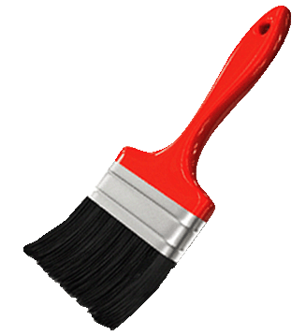
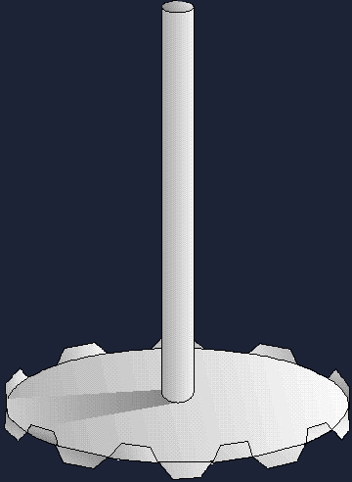
Clays Gelling Mechanism
SHEET LIKE
SWELLING
STRUCTURE TEMPORARY
DESTROYED
GEL STRUCTURE
NEEDLE LIKE
Notes:
When dispersing bentonites in water swelling of the additive is produced naturally and this helps the full dispersion of the material. A gel structure is produced which gives high viscosity at rest, this gel is destroyed under shear producing a drop in viscosity. This mechanism is the same for sepiolite products with the only difference that sepiolite will not swell when is placed in water.

Slide 9

Rheological effects
DIFFERENT MECHANISM SIMILAR EFFECTS
PSEUDOPLASTICITY
THIXOTROPY
Viscosity
Shear rate
Time

Slide 10
PANGEL
in
Water-based Systems

Slide 11
Water based
Rheological Additives
Non
Associative
Viscosity
Sedimentation
Can stability
Cellulosics
Acrylic ASE
Sag Resistance
Application
Consistency
Viscosity
Special
Clays
Leveling
Sepiolite
Montmorill.
Hectorite
Attapulgite
HEUR
HASE
Cellulosics
Acrylics
Associative
Clays have a strong
shear thinning profile (Pseudoplastic):
anti-Settling
sag control
good balance between levelling and sagging
Clays
HASE
HEUR
Shear Rate
Notes:
Rheology modifiers are used to control specific properties of the paint. Every paing property is related to the viscosity profile at some specific shear rate, for instance: high shear rate viscosity controls brushability and thickness of the film. Low shear rate viscosity controls sedimentation, sagging, can stability and how the paint is perceived by the consumer. Medium shear viscosity controls levelling and manufacturing parameters including pumpability. Every rheology modifier has a well defined rleological behaviour and makes it more efficient controlling viscosity at some specific shear rate.
Clays have a very shear thinning behaviour which makes them suitable to control sedimentation problems without modifying ICI viscosity. This behaviour makes clays a useful rheology modifier to be used together with organic thickeners.

Slide 12
Bentonite vs Sepiolite
Bentonite
  Better performance at low shear & high viscosity systems
  Better optical properties
  More sensitivity to temperature, pH and electrolytes
Sepiolite
  Better sedimentation
  Sediment if any, easier to redisperse
  Better sag control for same leveling

Slide 13
Bentonite vs Sepiolite
Attapulgite
  Better dispersion at low shear mainly in high viscous systems
  Lower cost per Kg
Sepiolite
  Better sedimentation
  Sediment if any, easier to redisperse
  Better sag control for same leveling

Slide 14
Additives for water-borne systems
Pangel S series: Rheological additives produced from high-purity sepiolite with outstanding suspension and anti-sagging capacity.
Pangel W series: Polymer modified rheological additives, specifically developed to enhance thickening and anti-sagging properties. Pangel W provides also water retention and excellent brushability.
Pangel M series: Rheological additives produced from high-purity bentonite for an easy gelling and dispersing capacity in high viscosity/high build coatings and ready-mixed adhesives and plasters.

Slide 15
Additives for water-borne systems
Pangel S9 | Purified sepiolite | High pseudoplasticity unaffected by electrolytes. A good replacement of Attagel 40 and 50 products in WB paints of medium/low solids content. Co-thickener of HEUR, ASE & Cellulosic thickeners. Highly effective in syneresis reduction.
Pangel W | Polymer modified sepiolite | Enhanced thickening efficiency. It provides open time and water retention of plasters and thick coatings. Total or partial replacement of HEC and acrylic thickeners. A Perfect alternative to Bentone LT.
Pangel M90F | Sodium bentonite | Stability and viscosity control with extremely fast dispersion capacity under high solid systems and low shear systems
Pangel M280 & M280F | Sodium bentonite | High pseudoplasticity and thickening capacity for high solids systems. Requires more shear than Pangel M90F to produce higher viscosity gels.

Slide 16
Benefits of PANGEL S9 in low-medium-solids in water based systems
Controls syneresis during storage
Higher efficiency than attapulgite based additives.
Increases resistance to sagging
Reduces sedimentation
They work synergistically with organic thickeners for increasing viscosity

Slide 17
Benefits of PANGEL M additives in high-solids water based systems
Improves workability
Increases resistance to sagging
Improves pumping and spraying
Reduces sedimentation and segregation during storage
Controls syneresis during storage
They also works synergistically with organic thickeners for increasing viscosity

Slide 18
Product recommendation chart

Slide 19
Organic Systems
TOLSA ORGANOCLAYS

Slide 20
Organoclays?
Organoclays are the result of the surface modification of clays mainly bentonites or sepiolites in order they can be dispersed in non aqueous systems
As in every coating formulation
dispersion is the secret of success
and surfactants have the key

Slide 21
Still a perfect choice for organic media
Organics
Polyamide wax
Hydrogenated
Castor Oil
Organoclays
Fumed silica
Ease of addition.
Mainly work as dispersants
Highly pseudoplastic very high thixotropy. High gloss. High thickness.
Activated by high temperature. Tendency to seeding. Rheology affected by temperature
Very highly pseudoplastic, thixotropy good enough for main applications. Easy handling. Rheology unaffected by Temperature
Impaired gloss, High shear is needed (not post addition)
High pseudoplasticity. Transparency
Difficult handling. Risk of over dispersion.

Slide 22
TOLSA Organoclays
OrganoBentonites
PANGEL OM
PANGEL OMD
PANGEL OM4
PANGEL OM8
PANGEL OMD1
PANGEL OMD2
OrganoSepiolites
PANGEL B
PANGEL B5
PANGEL B10
PANGEL B20
PANGEL B40

Slide 23
Main differences between
Pangel B & Pangel OM
OrganoBentonites
  Better dispersion at low shear
  Better optical properties
  Better in low solids systems
  Finer particle sizes
  Less sensitivity to surfactants
OrganoSepiolites
  Better sedimentation
  Sediment if any, easy to redisperse
  Better sag control for same leveling
  Better temperature stability
  Better in high solid systems

Slide 24
The Keys
01
Use always high shear dispersion
02
Order of addition in milling paste
03
Do not compare in pregel, do it in final formulations
Notes:
24

Slide 25
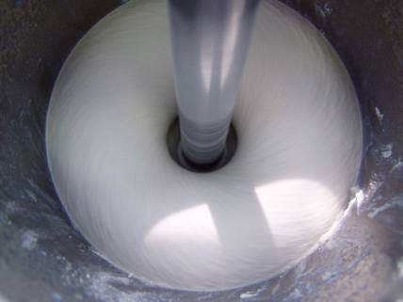
Dispersion is the key
Mixing conditions as with other rheological additives is a key step
High linear shear rates are recommended. Doughnut shape mixing mass is a good indicator of right mixing conditions
Peripheral Speed (m/s)
Notes:
25

Slide 26
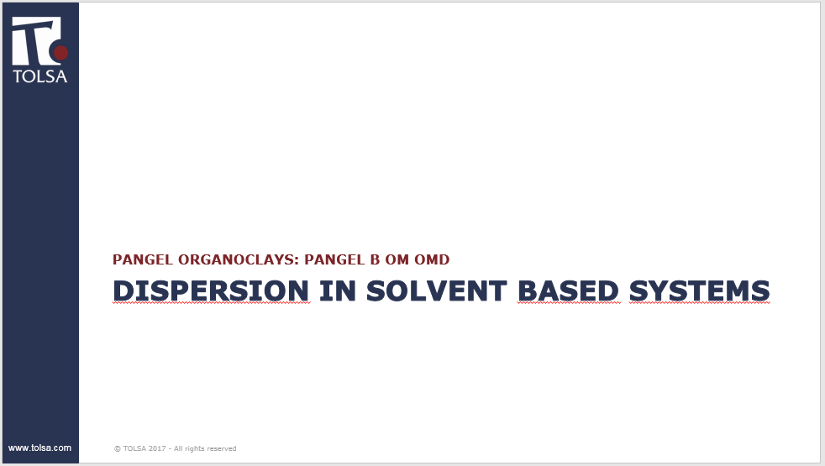

Slide 27
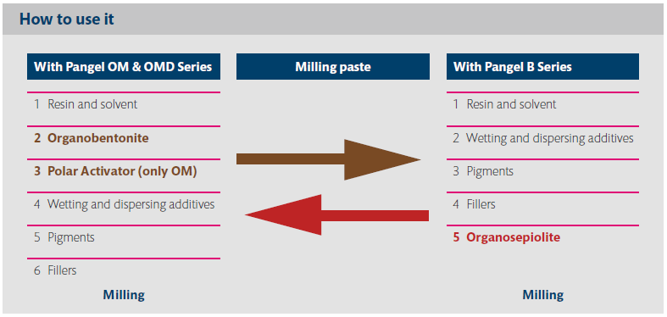
Order of addition
Notes:
27

Slide 28
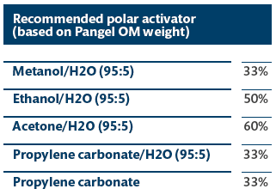
Pangel OM & OMD use
PANGEL OM4 & OM8 require the use of a polar activator at 30-60% on clay basis. This will normally be mixed with 5% of water in the mix. They are used for promoting the aggregation of bentonite platelets.
Polar activators are used when a pregel is made. Pregel normal concentration is between 5-6% clay concentration in solvent.
PANGEL OMD1 & PANGEL OMD2
Do not require polar activators.

Slide 29
Pangel OM and
the role of polar activators
Polar activators, and particularly the water contained in them are responsible of creating hydrogen bonds between platelets and therefore generate a gel structure
+
+
+
+
+
+
H₂O
+
+
+
+
+
+
+
+
H₂O
+
+
+
+
+
+
+
+
+
+
+
+
+
+
+
+
+
+
+
+
+
+
+
+
+
+
+
+
+
+
+
+
+
+
+
+
+
+
+
+
+
+
+
+
+
+
+
+
+
+
+
+
+
+
+
+
+
+
+
+
+
+
+
+
+
+
+
+
+
+
+
+
+
+
+
+
+
+
+
+
+
+
+
+
+
+
+
+
+
+
+
+
+
+
+
+
+
+
+
+
+
+
+
+
+
+
+
+
+
+
+
+
Shear
+
Solvent
+
+
+
+
+
+
H₂O
+
+
+
+
+
+
+
+
+
+
+
+
+
+
+
+
+
+
+
+
+
Polar
activator
H₂O
+
+
+
+
+
+
+
+
+
+
+
+
+
+
Solvent
+
+
+
+
+
+
+
+
+
+
+
+
+
+
+
+
+
+
+
+
+
+
+
+
+
+
+
+
+
+
+
+
+
+
+
+
+
+
+
+
+
+
+
+
+
+
+
+
+
+
+
+
+
+
+
+
+
+
+
+
+
+
+
+
+
+
+
+
+
+
+
+
+
+
+
+
+
+
+
+
+
+
+
+
+
+
+
+
+
+
+
+
+
+
+
+
+
+
+
+
+
+
+
+
+
+
+
+
+
+
+
+
+
+
+
+
+
+
+
+
+
+
+
+
+
+
+
+
+
+
+
+
+
+
+
+
+
+
+
+
+
+
+
+
+
+
+
+
+
+
+
+
+
+
+
+
+
+
+
+
+
+
+
+
+
Modified
clay
+
+
+
+
+
+
+
+
+
+
+
+
+
+
+
+
H₂O
+
+
+
+
+
+
+
+
+
+
+
+
+
+
+
+
+
+
+
+
+
+
+
+
+
+
+
+
+
+
+
+
Swelling
+
+
+
+
+
+
+
+
+
+
+
+
+
+
+
+
H₂O
Dispersion
No gel structure
Gelling
(gel structure development)
Notes:
29

Slide 30
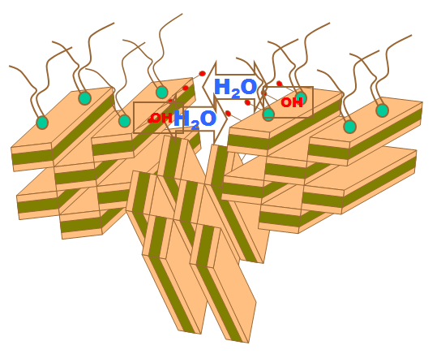
Pangel B mechanism of gelling
PANGEL B products form a three dimensional network of intermeshed microfibres that is physically stable even at high temperatures.
The network of fibres are further stabilised by hydrogen bound through H2O or polar molecules, established between surface hydroxyl groups of adjacent particles. So no activators are required.
To achieve a correct dispersion of PANGEL B microfibres it is necessary to use high shear dissolver (recommended peripheral speed : 18-25 m/s)
Notes:
30

Slide 31
When comparing organosepiolite with organobentonites
With Pangel B grades, the use of polar activator is not required as they will produce a drop in viscosity of the milling paste
Pangel B grades will get better performance when there is not free dispersant in the vessel, therefore addition of Pangel B is preferred after pigments and/or fillers during milling paste preparation
Performance against organobentonite should be evaluated in final formulation not in only solvent systems (pregels)
Notes:
31

Slide 32
TOLSA ORGANOCLAYS
Rheological additives for organic systems
Serie | Nature | Polar Activator | Self-dispesing | Is it possible To Pregel? | Grades | Polarity
Pangel B | Organo-sepiolite | No need but they can be used | Yes | Yes | B5 B10 B20 B40 | Very Low Low Medium-Low High
Pangel OM | Organo-bentonite | Yes | No | Yes | OM4 OM8 | Low Medium
Pangel OMD | Organo-bentonite | No | Yes | No | OMD1 OMD2 | Low-Medium High

Slide 33
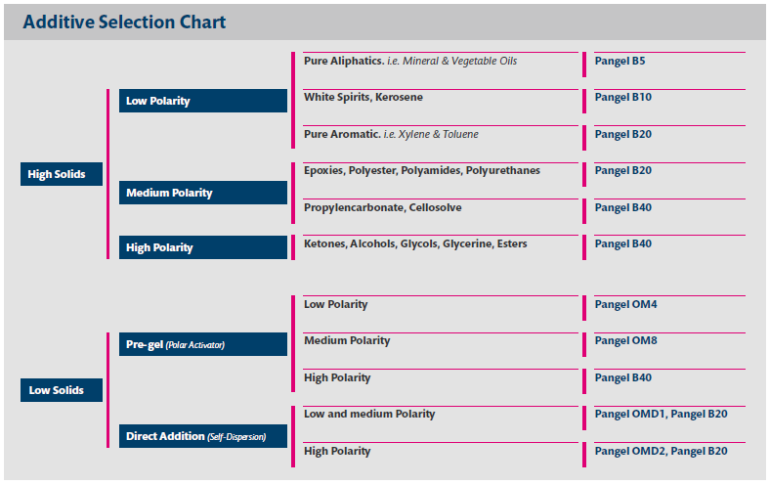
Selection Chart for organic media

Slide 34
Additives for solvent-borne systems
Low Polarity
Intermediate Polarity
High Polarity
Lubricant greases, drilling muds...
Alkyd and anticorrosive paints, offset inks, road paints, asphalts in solvents
Alkyd and anticorrosive paint, epoxy 2K, primers, unsaturated polyester, adhesives...
Adhesives, foundry coatings, paint strippers, Acetone based road paints...
Pangel B5
Pangel B10
Pangel B20
Pangel B40
Pangel OM4
Pangel OM8
Pangel OMD1
Pangel OMD2

Slide 35
Pangel Polarity Chart
LOW
POLARITY
MEDIUM
POLARITY
HIGH
POLARITY
Mineral
oil
Kerosene
Xylene
Vegetable oil
Epoxy
Propylen-
carbonate
Acetone
Carbitol
Ethyl
Acetate
Methanol
Aliphatic
White
Spirit*
Toluene
Polyamide
Dioctyl-
phthalate
Methyl
Ethyl
ketone
Ethylene glycol
Buthyl Acetate
Ethanol
Hexane
Solvent
Naphta
Turpentine
Polyester
Heptane
Odourless White Spirit**
Heavy Solvent Nafta
Dipentane
Styrene
Dibutile Phtalate
Cellosolve
Methyl
Isobuthyl
ketone
Glycerin
Amyl Acetate
Propanol
B5
B10
B20
B40
OM4/OMD1
OM8
OMD2
Notes:
35

Slide 36
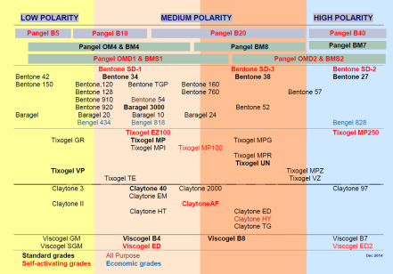
Direct offsets
Some direct offsets for OM/OMD grades
PANGEL OM4
Bentone 34
Bentone 1000
Tixogel VP
Tixogel VPA
Tixogel MP
Perchem 44
Claytone 40
PANGEL OM8
Bentone 38
Claytone ED
Tixogel UN
Tixogel MPG
Viscogel B38
PANGEL OMD1
Bentone SD-1
Bentone SD-3
Tixogel EZ-100
Tixogel MP-100
Claytone AF
Claytone HY
PANGEL OM2
Bentone SD-2
Benathix
Tixogel MP-250
Claytone APA
Check here our full offset table for a more complete information
Notes:
36

Slide 37
Some characteristics of PANGEL M
 | M90 | M90F | M280 | M281
Moisture Content (%) | 9.8 | 10.5 | 10.5 | 10.8
Dry sieving (%) Fraction retained in150µm | 0.0 | 0.0 | 1.9 | 1.8
Fraction retained in 75µm | 12.6 | 0.7 | 19.4 | 19.5
Fraction below 45µm | 58.6 | 82.3 | 48.7 | 47.7
Wet sieving (%) Fraction retained in 75µm | 0.9 | 0.0 | 1.6 | 1.9
Fraction below 45µm | 96.9 | 98.0 | 97.5 | 96.7

Slide 38
Paints & Coatings
WATER BASED
-Examples-

Slide 39
Acrylic latex enamel semigloss
Lb/100 gallons
Attapulgite
Pangel S-9
Pangel S-9
Water
104.25
104.25
104.25
Propylene Glycol
21.6
21.6
21.6
Colloid 643
1.46
1.46
1.46
Tamol 731-25%
9.58
9.58
9.58
Dowicil 75
0.83
0.83
0.83
Nopcocide N-96
5
5
5
Unitane OR-600
208.34
208.34
208.34
Polygloss 90
29.95
33.2
35.16
Attapulgite
8.33
-
-
Pangel S-9
-
4.17
2.77
Disperse high speed 20 min.
Water
300.18
300.18
300.18
Acrysol EXP-300
21.27
21.27
21.27
Rhoplex AC-64
310.94
310.94
310.94
Colloid 643
2.92
2.92
2.92
Texanol
9.88
9.88
9.88
Ammonia
1.54
1.54
1.54
Totals
1036.07
1035.16
1035.72
PVC (%)
28
28
28
Solids by weight (%)
43.8
43.8
43.8
Solids by volume (%)
30.1
30.1
30.1
Notes:
This chart refers to a water base deco paint were a system of acrylic and attapulgite thickeners are used. Attapulgite has been replaced by Pangel S9 at half and one third of the original dosage. Solid content is kept constant increasing the amount of talc (Polygloss 90).

Slide 40
Results
Attapulgite
Pangel S-9
Pangel S-9
8.33
4.17
2.77
Consistency (KU)
123
123
120
1
Fineness of Grind (Hegman)
6
6
6
Reflectance, Y value (%)
91.3
91.5
91.5
Contrast Ratio
0.984
0.98
0.977
Relative Tint Strength (%)
0
0.6
-2.9
Sheen, 85°
69.3
73.5
73.9
Gloss, 60°
34.1
35.8
35.1
Leveling (10=perfect)
8
9
9
2
Sag resistance (Mils)
12+
12+
12+
Viscosity, ICI (Poise)
0.95
0.85
0.83
Oven stability, 1 week, 60 °C
Excellent
Excellent
Excellent
Notes:
As can be seen consistency (1) is maintained at half dosage of Pangel S9 and it can be seen an slightly improvement in the optical properties of the paint . Levelling is improved and sag resistance has not been affected (2). Further reduction of dosage of Pangel S9 gives a small decrease of consistency. So it is proved that is possible to replace attapulgite maintaining consistency an improving optical and rheological properties with a replacement ratio in the region of the 2:1 to 3:1.

Slide 41
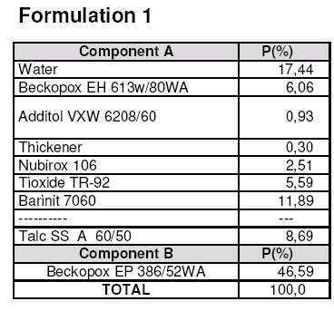
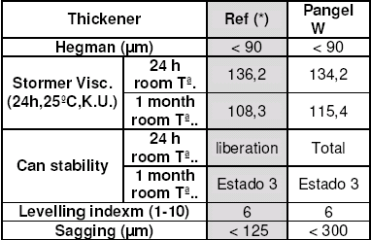
Pangel W in WB Epoxy Paint
Incorporation in Polyamine component
1
* Organically modified bentonite for water based systems
Clear improvement in sag control
Notes:
Pangel W has been tested against organically modified bentonite in two formulations of water based epoxy anti-corrosive paints. In this formulation part A has been formulated using the polyamino component. A big increase of the sag control of the paint can be observed (1) having the same consistency and the same levelling.
41

Slide 42
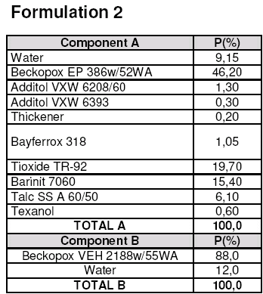
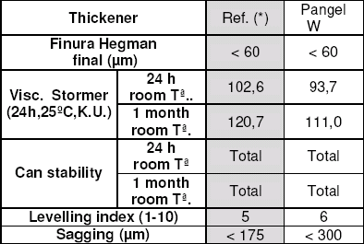
Pangel W in WB Epoxy Paint
Incorporation in the resin component
1
Clear improvement in sag control
Notes:
Pangel W has been tested against organically modified bentonite in two formulations of water based epoxy anti-corrosive paints. In this formulation part A has been formulated using the epoxy component. A big increase of the sag control and levelling of the paint can be observed (1).
42

Slide 43
Paints & Coatings
SOLVENT BASED
-Examples-

Slide 44
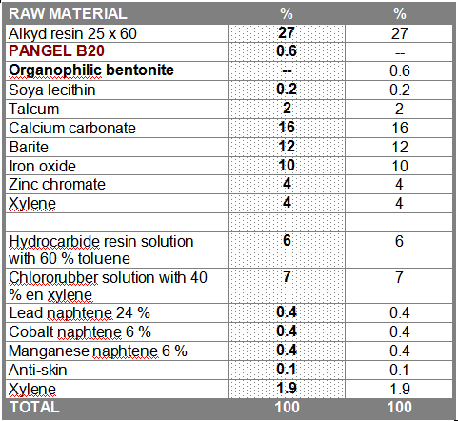
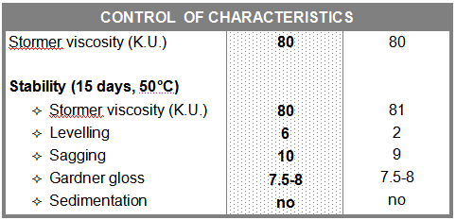
Zn Primer with Pangel B20
Synthetic zinc primer with Pangel B20 in comparison with Bentone SD1
Better sag/leveling
Same atisedimentation
Better cost
Notes:
This is a solvent based epoxy formulation where Pangel B20 has been tested against conventional and new family of organobentonites.
44

Slide 45
Pangel B20 in 2K Epoxy
High Solids Gloss White Enamel. Pangel B20 will be tested against conventional and new generation organobentonite
Notes:
This is a solvent based epoxy formulation where Pangel B20 has been tested against conventional and new family of organobentonites.
45

Slide 46
Pangel B20 in 2K Epoxy
Better stability compared with conventional organobentonite. Compares favourably with high cost organobentonite (7-8 €/kg)
Good rheological profile. High zero shear viscosity and low ICI viscosity
Notes:
Pangel B20 has been evaluated at same dosage against a conventional organobentonite (Bentone 34) which requires polar activator and new organobentonite (Garamite 1958). The result is that only Pangel B20 and Garamite gives a stable formulation. In the viscosity graph can be seen that Pangel B20 produce the formulation with highest zero shear viscosity.
46

Slide 47
Hydrosoluble paints
They are based in mixtures resins/ water/solvent and are a suitable alternative to decrease the VOC in solvent based paints.
PANGEL B20 has high compatibility with these systems due to its high density of active center (OH groups) on the surface.
Notes:
VOC: volatile organic component (solvent)
47

Slide 48
Hydrosoluble
White Primer for Wood
Components Weight % weight Volumen % volumen
Residrol AY 430w/42WA 89,0 34,4% 74,2 46,4%
Milling Paste 170,0 65,6% 85,8 53,6%
Total: 259,0 100% 159,9 100%
Milling Paste:
Water 66,6 22,2% 22,2 44,0%
additol VXW 6208 (dispersant) 8,1 2,7% 2,7 5,4%
additol XL 297 (anti-skin) 1,5 0,5% 0,5 1,0%
additol VXW 6214 (leveling) 0,6 0,2% 0,2 0,4%
additol VXW 4973 (Deaireant) 2,1 0,7% 0,7 1,4%
Acrysol RM 2020 (PU-newt.) 8,1 2,7% 2,7 5,4%
Titanium dioxide 69,0 23,0% 5,6 11,1%
Celite 281 24,0 8,0% 3,5 6,9%
Omyacarb 5BE 48,0 16,0% 5,9 11,7%
Barite 48,0 16,0% 3,6 7,0%
Talc 24,0 8,0% 2,9 5,8%
total: 300,0 100% 151,3 100%
Solid content: 61,7%
PVC: 52,8%
pigment/binder (p/p): 3,08
Formulation with high solid content, therefore thickener has to improve settling as well as sagging and levelling.
Pangel B20 will be tested modifying addition level of dispersant and newtonian thickener
48
Notes:
This starting point formulation has newtonian PU (polyurethane) thickener and suffer from can stability problems and poor sag control. Pangel B20 has beed tested with the aim of improving this performance. Together with the addition of Pangel B20 adjustments in the addition of thickener and dispersant have been evaluated.
48

Slide 49
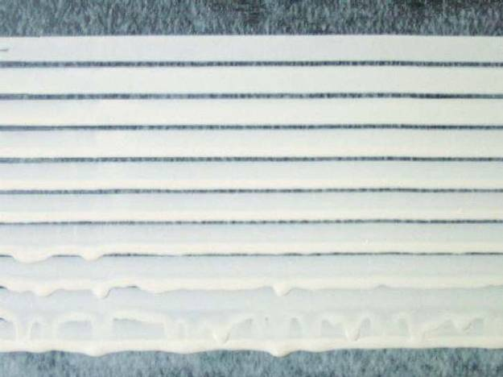
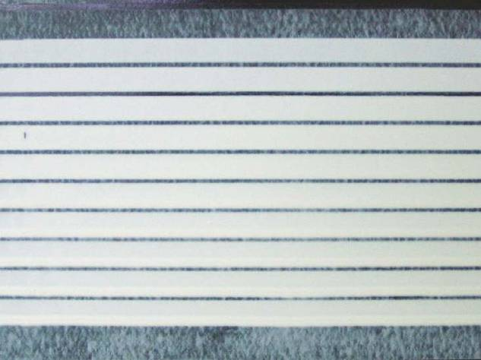
Pangel B20 in
Hydrosoluble Paints
RESULTS
Formulation 1 2 3 4 5
additol VXW 6208 2,7% 2,7% 3,0% 2,7% 2,7%
Acrysol RM 2020 2,7% 2,7% 2,7% 2,0% 1,5%
Pangel B20 ⎯ 0,4% 0,5 0,5% 0,6%
PROPERTIES
Visc. Stormer
(25 ºC, KU) 104 108 112 111 112
Visc. Brookfield
(25 ºC, 5rpm,
sp#2, mPa·s) 1.680 2.400 ⎯ 3.200 3.040
Sag resistance 225 μm 300 μm 300 μm 300 μm 300 μm
Leveling 6 5 6 6 3
Solid content
(1 h@105 ºC, %) 64% 63% 65% 64% 65%
Stability in can 4 3 2 2 3
Notes:
It can be seen in formula 1 that the original formulation suffer from poor can stability and poor sag resistance. Addition of 0,4% of Pangel B20 improves sag resistance and only a little can stability.
An increase in the addition of Pangel B20 is needed and expected increase of consistence is balance reducing the amount of PU thickener or increasing the amount of dispersant. Both cases full sag control has been achieved without impairing the levelling of the paint and can stability has further improved from clear presence of sediment in the original to slightly filling of sediment. The last attempt increasing the dosage of Pangel B20 and reducing the amount of PU thickener affects negatively the levelling of the paint. So finally, the best formulation is number 2 where the addition of PU thickener has been reduced in 26% in order to have the same consistence after addition of 0,5% of Pangel B20. The new formulation has much better can stability and sag control keeping the same levelling.
49

