Slide 1

Ruisil Water Proofing Agents
Can Help Protect Your
Concrete Structures

Slide 2
Any concrete structure faces life shortening processes as a result of attack by water and waterborne salts

Slide 3
Common ways water attacks
concrete structures include:
Corrosion of steel reinforcement
Chloride attack
Sulfate Attack
Alkali aggregate reaction (AAR)
Effects of freeze/thaw cycles

Slide 4
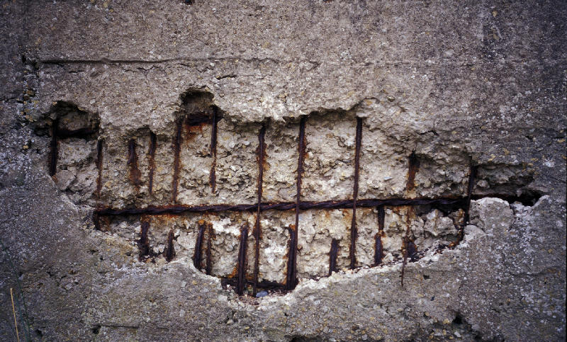
3 essential components necessary for corrosion to take place in reinforced concrete:
Corrosion of steel reinforcement
Electrolyte for ion transfer (water)
Conductor for electron transfer (steel reinforcement)
Oxygen
Eliminating one of the elements of the corrosion triangle will mitigate the damage due to corrosion

Slide 5
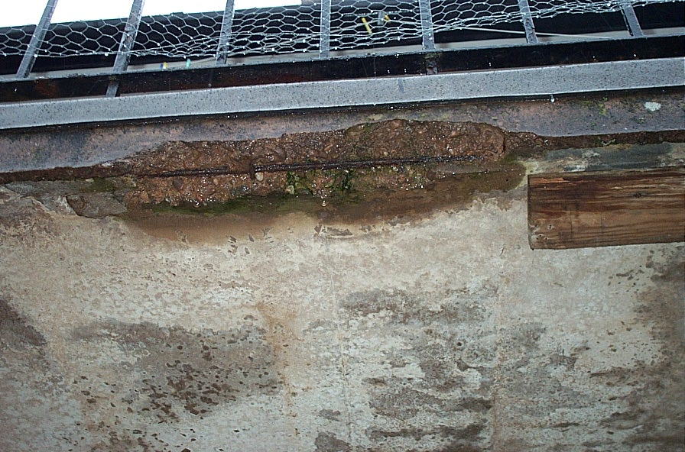
Chloride Attack
Different types of concrete will have more connected pores and larger capillaries than others.
As a result, the potential for ingress of
detrimental substances into the concrete
will increase leading to the breakdown of
the passive layer around the rebar.
Reducing/eliminating water ingress into the concrete will prevent the opportunity of chloride attack

Slide 6
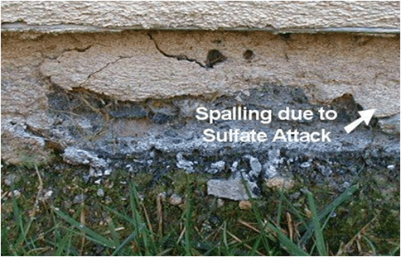
Sulfate Attack
The most common type of sulfate attack is through external means. Water containing dissolved sulfate can penetrate and cause several problems within the concrete structure:
Extensive cracking
Expansion
Loss of bond between
the cement paste and
the aggregate

Slide 7
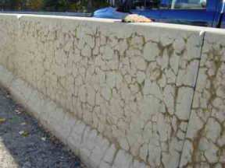
Alkali Aggregate Reaction (AAR)
Certain aggregates can react with the alkali hydroxides in concrete causing deterioration of the concrete structure through expansion and cracking. Alkali-Silica Reaction (ASR) is the most common type.
In this reaction, the silica in the aggregate
reacts with alkali hydroxide in concrete
and forms a gel. This gel swells by
absorbing water. Preventing water ingress
will help prevent the swelling and resulting damage.

Slide 8
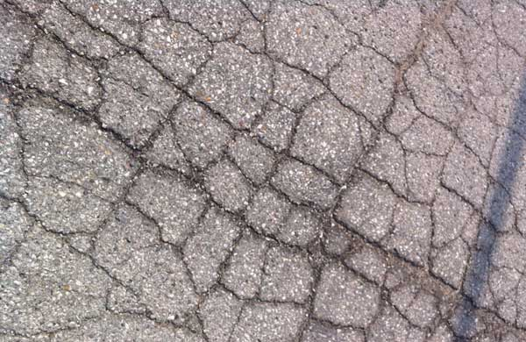
Freeze/Thaw Cycles
Freeze/Thaw actions will likely cause significant deterioration to concrete especially non-air entrained concrete. When water freezes, it occupies 9% more volume. Without available space for the increased volume, deterioration/damage can occur such as spalling and scaling, surface cracking or exposure of aggregate.
By eliminating water penetrating the
concrete surface, these issues can be
Greatly reduced

Slide 9
Why Select a Penetrating Sealer
Coating type sealers tend to remain on the surface limiting their effectiveness/durability
Penetrating/reactive sealers go inside of the concrete matrix and chemically react increasing the durability and weatherability – Reactive sealers include Silanes and Siloxanes

Slide 10
General Types of Sealers
Non-Reactive Sealers coat the concrete surface but do not react with the concrete itself. They typically have a finite life (3 – 5 yrs.) and can hinder bonding of other materials to the concrete.
Reactive Sealers penetrate the concrete and react with it chemically. This reaction occurs quickly and the by-product of the chemical reaction is alcohol which evaporates. The two most common reactive sealers are siloxanes and silanes.

Slide 11
Ruisil’s Products
can help eliminate the problems
caused by water penetration

Slide 12
Penetrating Sealers
Forms chemical bond with the walls of the pores, the pores themselves, or both
Does not change the substrates appearance
Better long-term effectiveness in traffic abrasive environments
Does not plug substrate pores
Leaves the substrate water and salt repellant, yet still permeable
They penetrate into the substrate to form a hydrophobic barrier within the pores that repels water and other liquids.

Slide 13
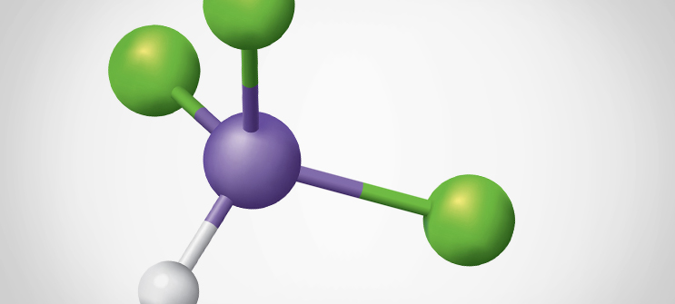
Silane Chemistry
A silane is a molecule comprised of one central silicon atom with four attachments. These substituent groups can be nearly any combination of nonreactive, inorganically reactive, or organically reactive groups. Silanes are the smallest silicon-based molecules, ensuring good depth of penetration into substrates. A silane that contains at least one carbon-silicon bond structure is known as an organosilane. In many applications, the term “silane” is a generic term typically referring to an organofunctional alkoxysilane
They react with themselves and any hydroxyl (OH) groups within the substrate, often when moisture is present, forming a silicone resin network. This formation of strong chemical bonds provides durability.

Slide 14
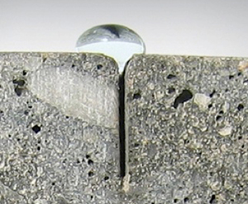
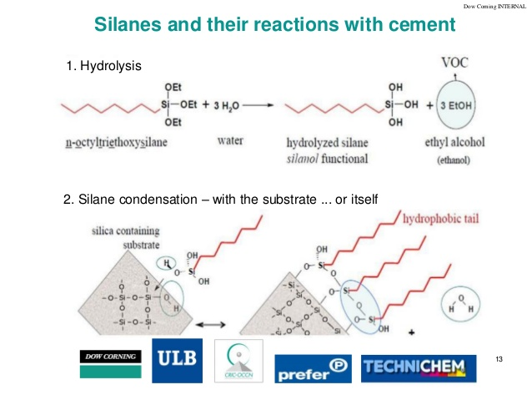
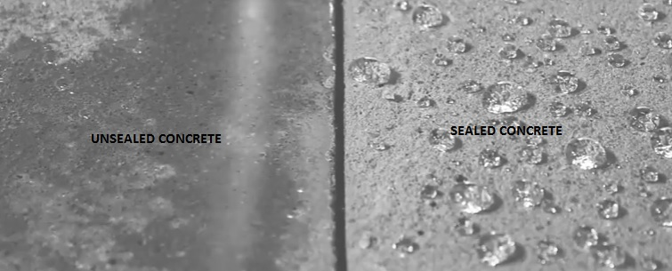
Unsealed Concrete
Sealed Concrete

Slide 15
RUISIL offers both Silane and Siloxane water repellents to make your product more effective and increase the durability and weatherability

Slide 16
Water Repellant Products to meet your formulation needs:
RJ-202E 50% Active Silicone Emulsion in Water
RJ-H80 Moisture Crosslinking Powder – Silane/Siloxane Powder Form
RJ-SR05 95% Solid Self Leveling Polyurethane Water Proof Coating
RJ-WP01 Water dilutable Potassium Methyl Siliconate 42% solids
RJ-WP01 Water dilutable Potassium Methyl Siliconate 52% solids
RJ-WP03E 45% Active Silane/Siloxane Emulsion in Water (Non Ionic)
RJ-WP08E 40% Active Silane Emulsion with strong penetrating ability
RJ-WP09E 40% Active Silane/Siloxane Emulsion – Additive for paints
RJ-WP18 100% Active Solvent Free Mixture of Silane/Siloxane/Silicone Resin
RJ-WP19 80% Active Mixture of Silane/Reactive Siloxane/Silicone Resin
RJ-WP21 100% Active Nano Technology for Solvent Borne Systems
RP-WP28 20% Active Fluoro-Silicone Compound in Kerosene

Slide 17
Additional Substrates
Mortar
Cementitious Boards
Brick
Roof Tiles
Marble
Stone/Sandstone
Insulation Materials
Gypsum Board
Wood

Slide 18
For Information/Samples/Formulation Assistance
Please contact one of our team members:
Lily Wu Kathy Wachala
Sales Manager Business Director NA
silicone02@ruijianggroup.com kwachala@ruijianggroup.com
904-625-1418
Gary Kline
US Technical Leader
gkline@ruijianggroup.com
571-525-8196

